Slide 1
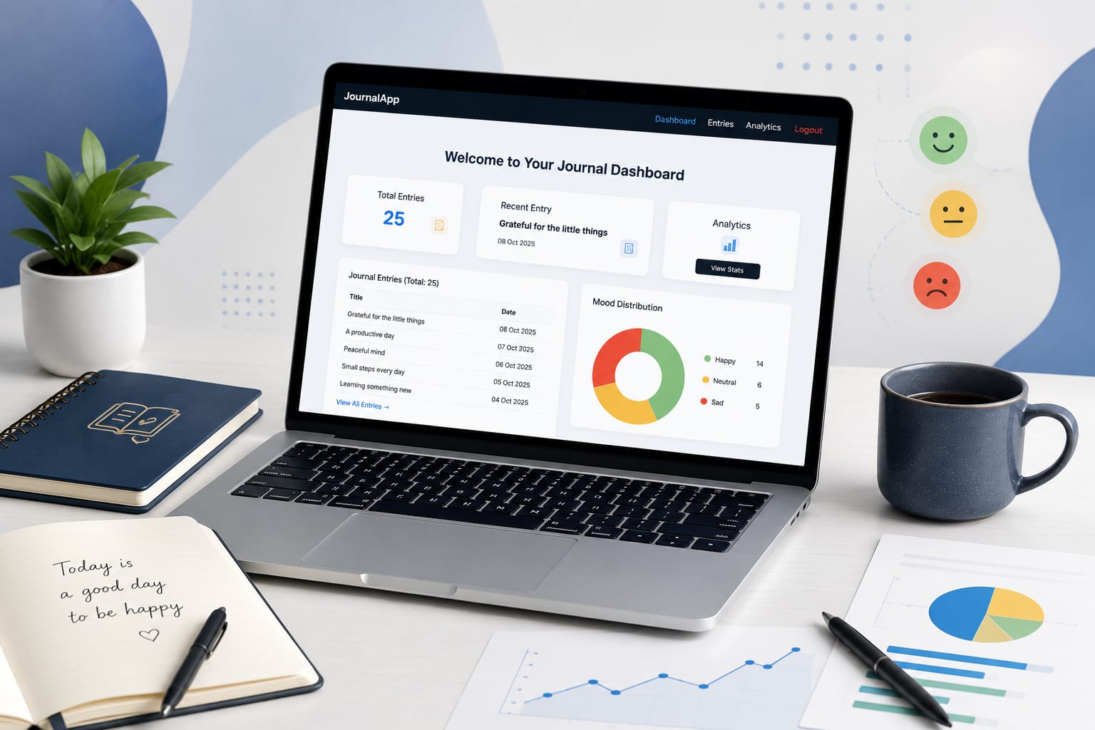
Personal Journal Analytics Web Application Your stories, your moods, your insights—all in one place.
Cheyyeti Hasini

Slide 2
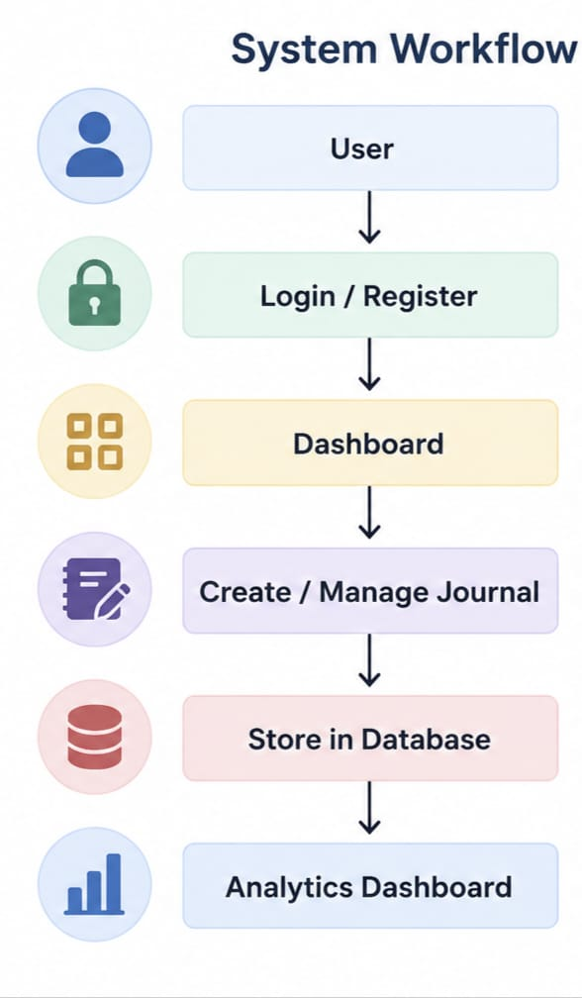
Project Overview
The Personal Journal Analytics Web Application is a secure web application that enables users to record daily journal entries, manage them efficiently, and gain meaningful insights through mood analytics. It combines journal management with interactive visualizations to support self-reflection and emotional tracking.
Key Features :-
✔️ Secure User Authentication
✔️ Journal Management (CRUD)
✔️ Mood Tracking
✔️ Interactive Analytics Dashboard
✔️ MySQL Database Integration

Slide 3
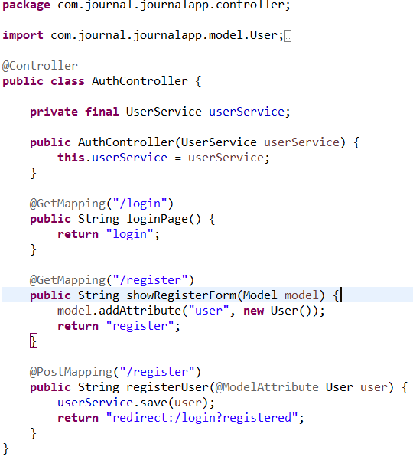
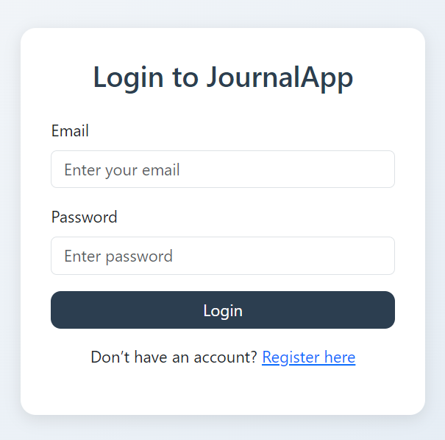
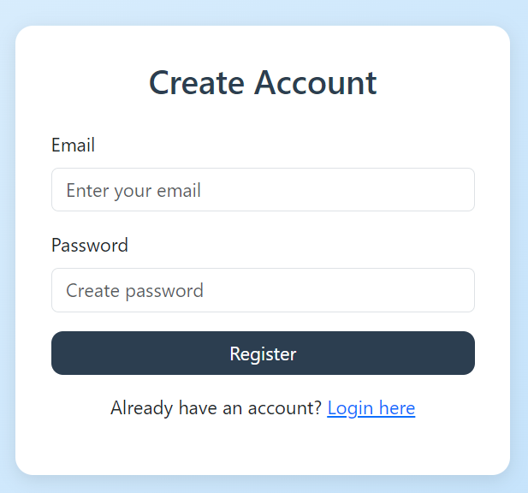
Authentication Module
Features
Secure user registration
User login authentication
Session-based access control
Password validation
Secure access is the first step toward protecting personal memories

Slide 4
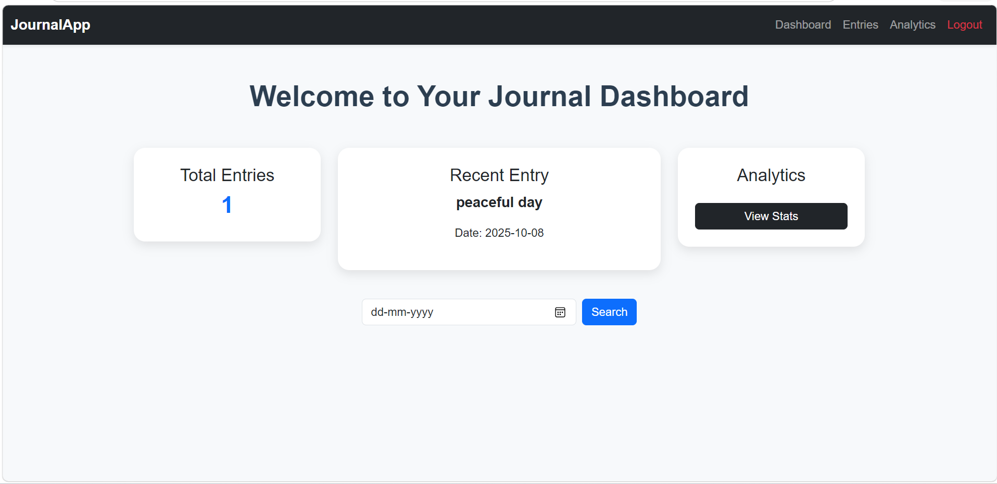
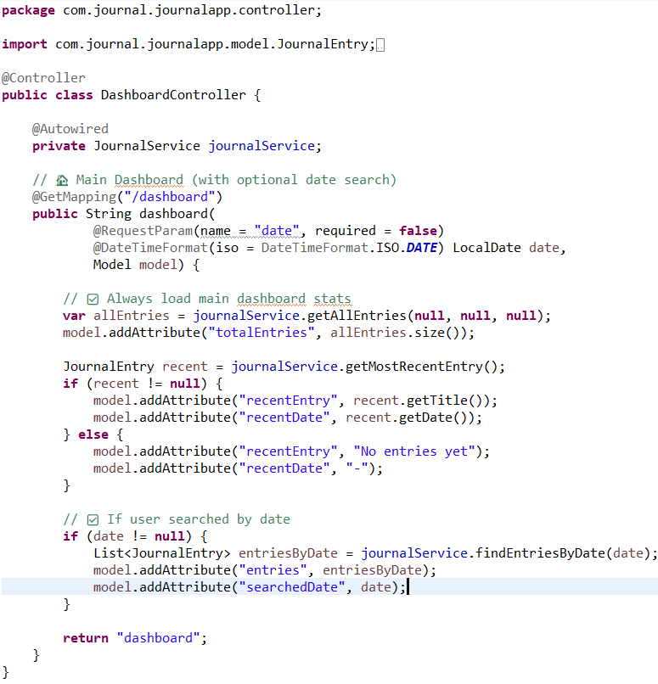
Dashboard Module
Features
Displays total journal entries
Shows recent journal entry
Search entries by date
Quick access to Analytics
Easy navigation between modules

Slide 5
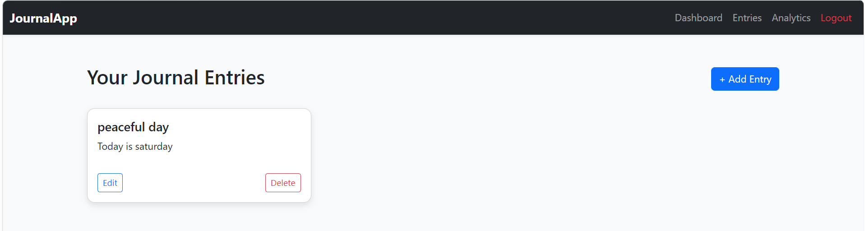
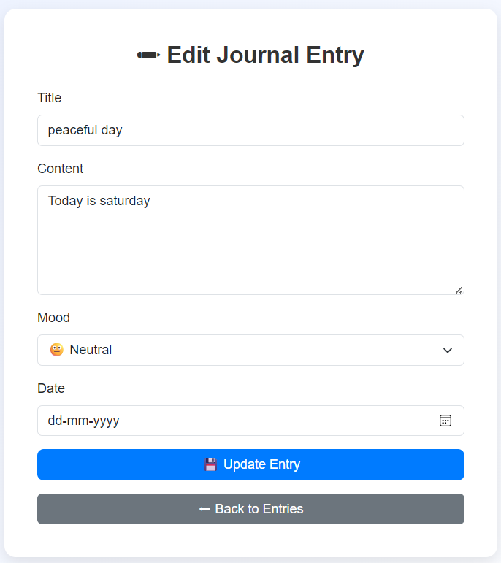
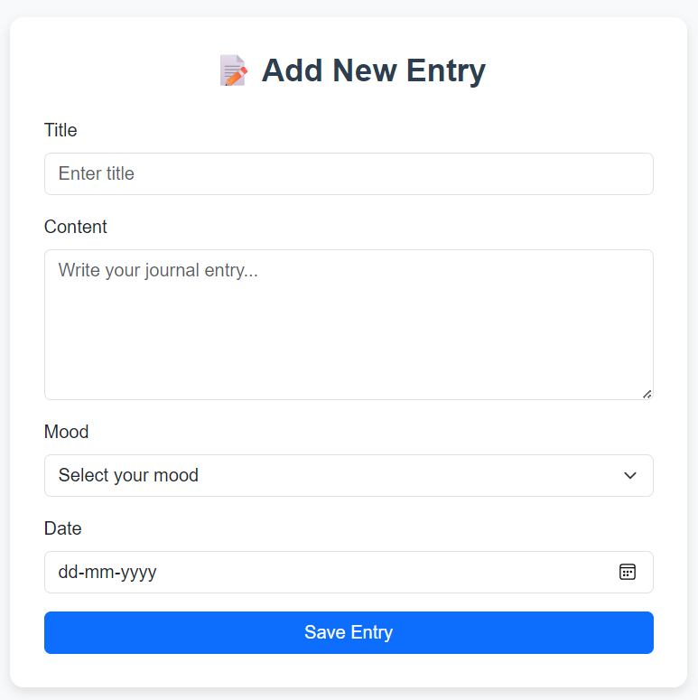
Journal Management Module
Features
View all journal entries
Add new journal entries
Edit existing journal entries
Delete journal entries

Slide 6
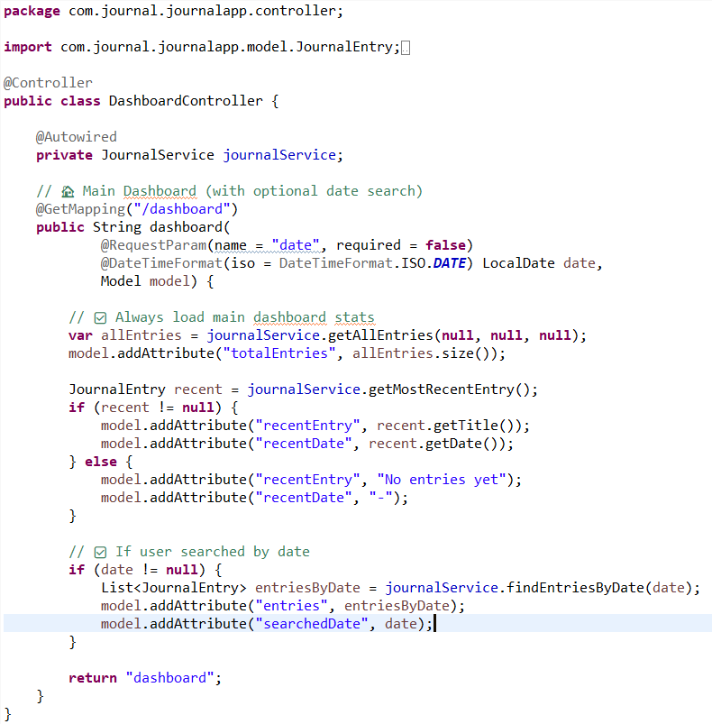
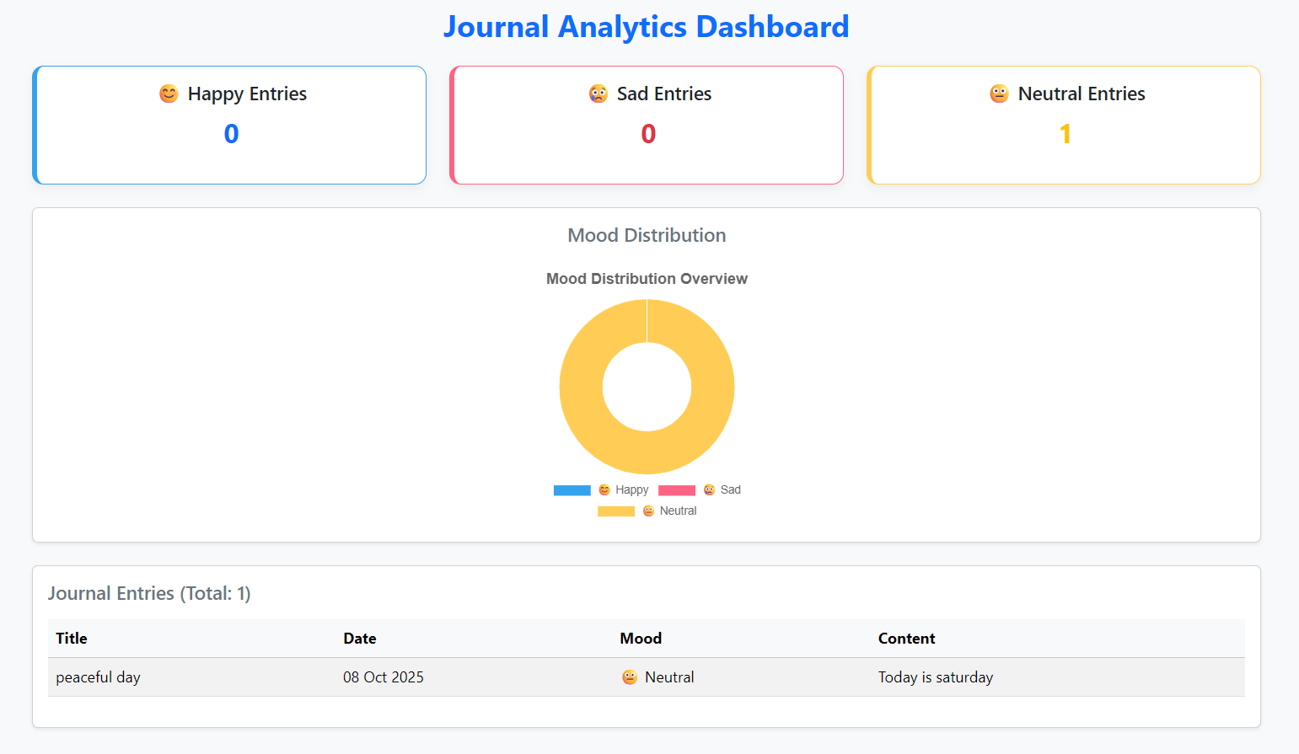
Analytics Module
Features
Displays mood-wise journal statistics
Visualizes mood distribution
Tracks Happy, Sad, and Neutral entries
Provides an interactive analytics dashboard
Supports data-driven self-reflection

Slide 7
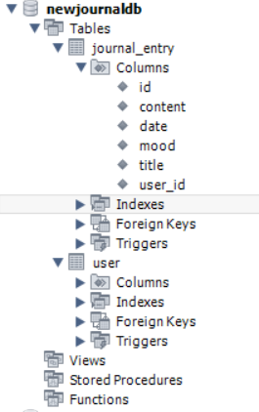
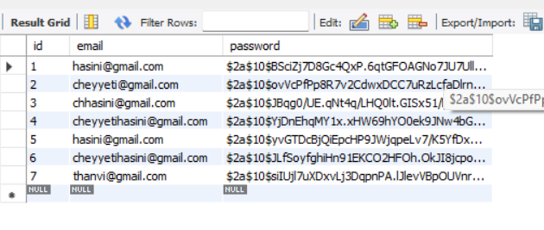
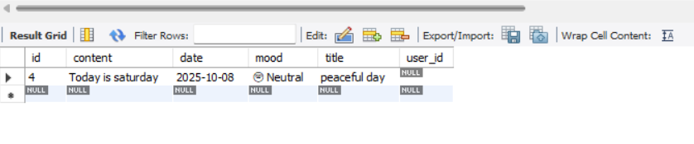
Database Integration (MySQL)
Database Structure
User Table
Journal Entry Table
Notes:
Journal Entry Table

Slide 8
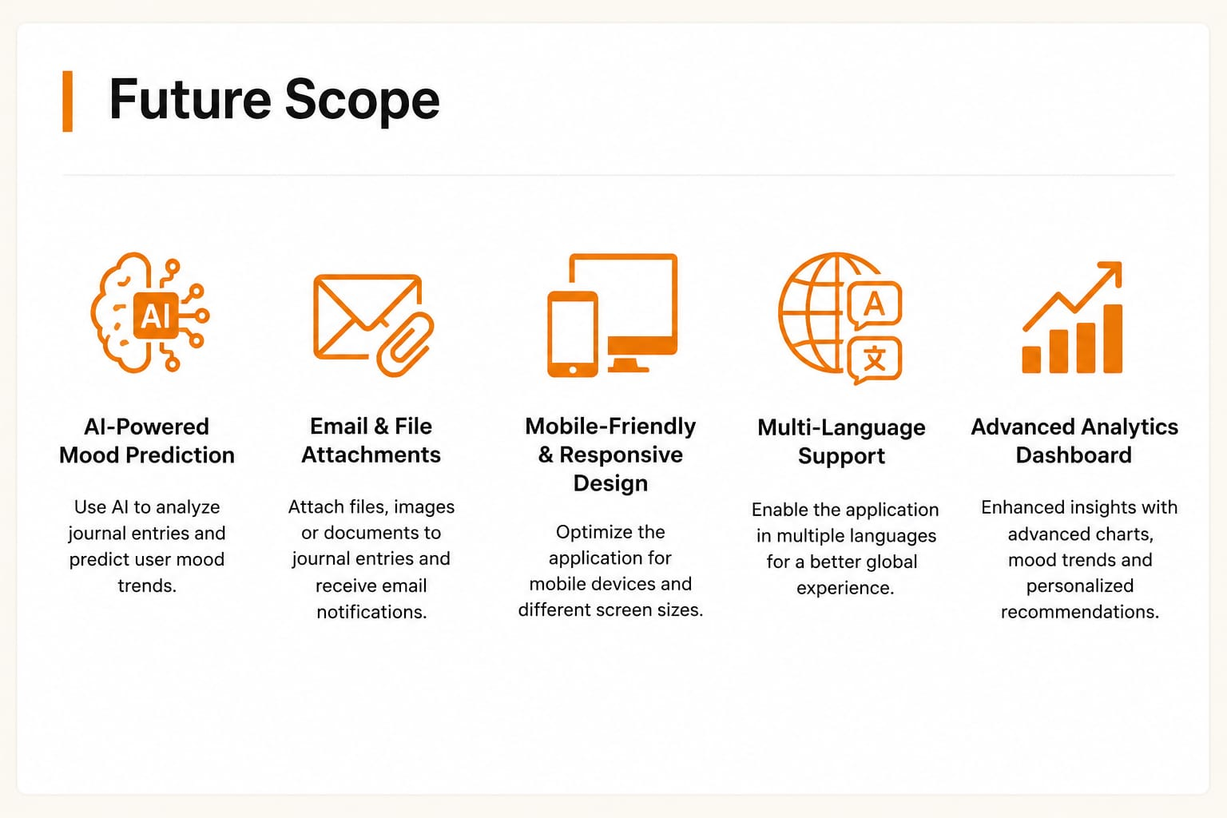

Slide 9
Thank You

